Slide 1
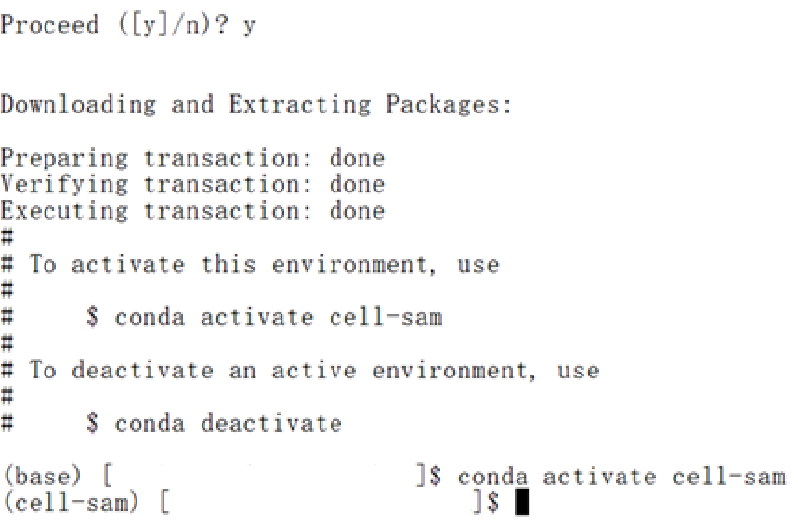
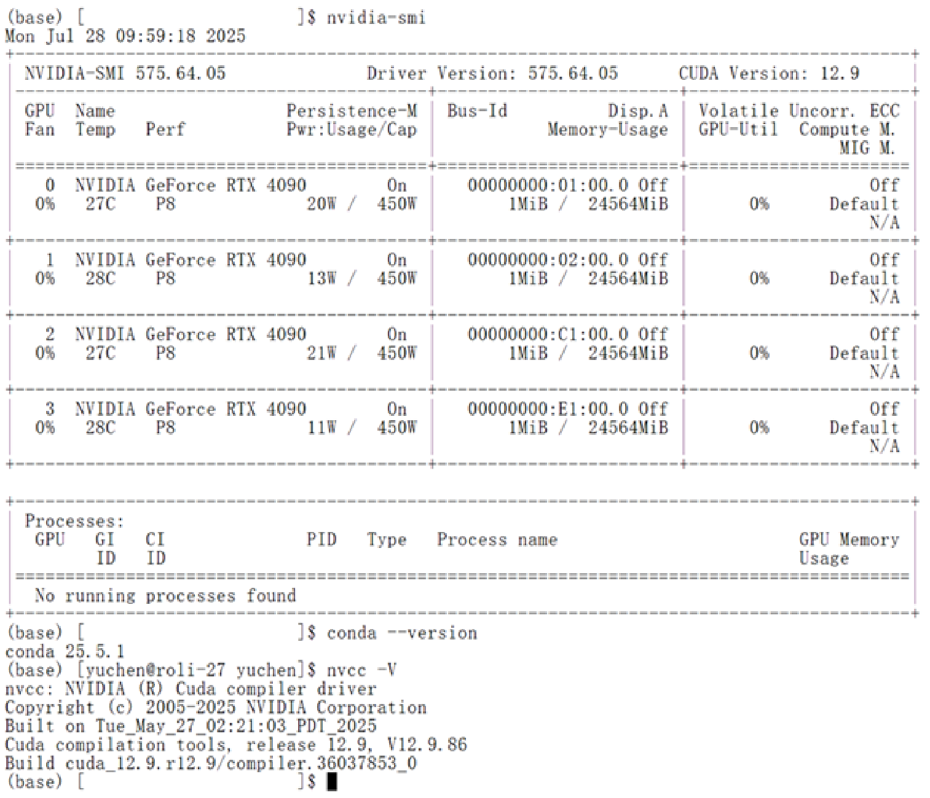
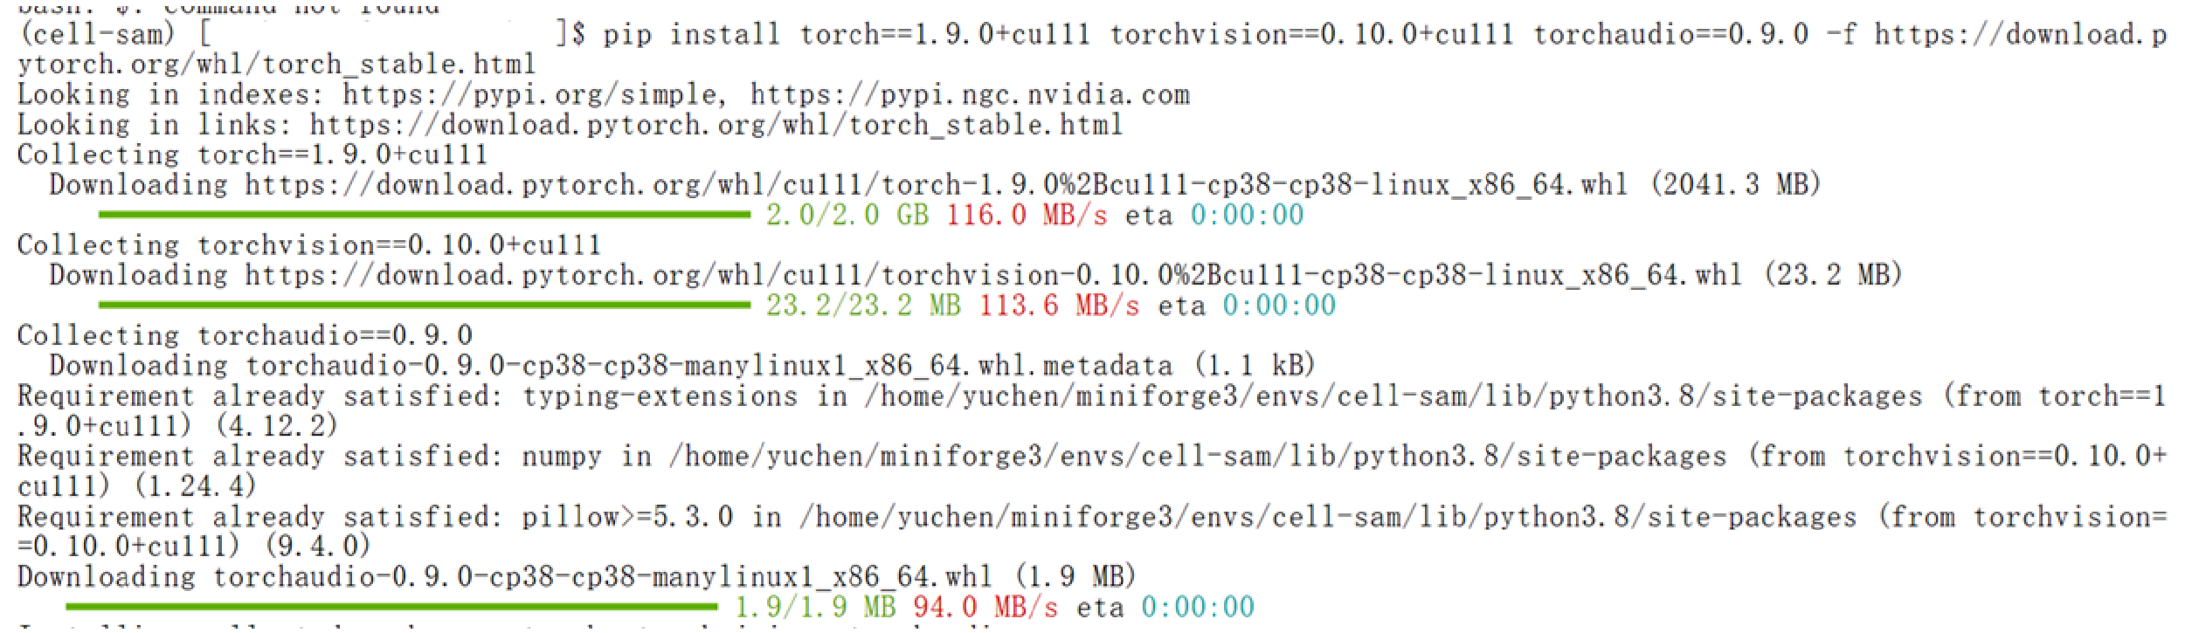
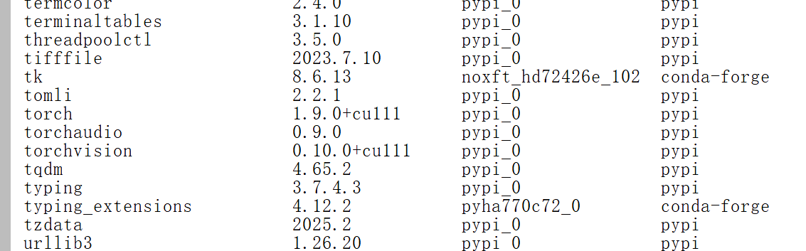
More detailed instructions can be found in YCWu-nk/Cell_SAM: Large-scale segmentation model facilitates intraoperative histopathology by third harmonic generation microscopy, you can directly copy them
2. Creating a conda environment, and install the GPU version of PyTorch in your preferred way:
1. We suggest confirming that the basic environment is installed correctly first:
You can use any ways you want as long as this can be achieved, as some countries, regions, or research institutions require VPN or downloading from mirror sources
Please confirm again through ‘conda list’ !
‘+cu’ is right
‘cpu’ is wrong

Slide 2
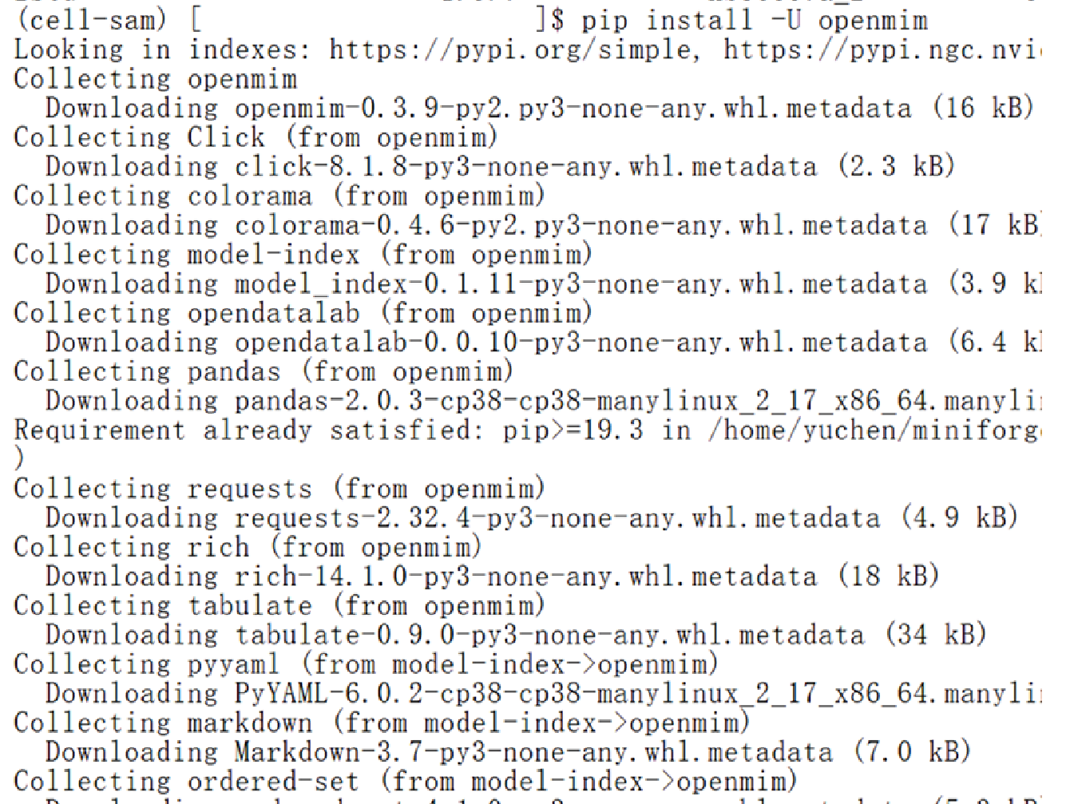
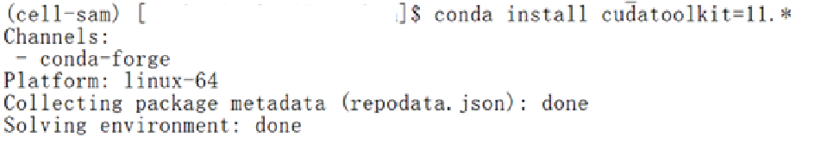
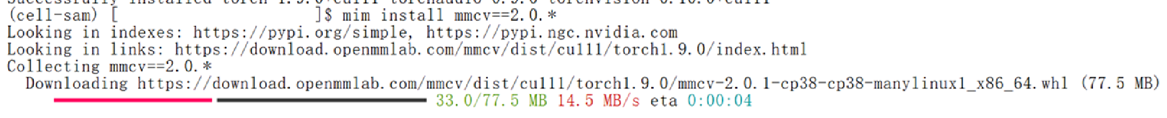
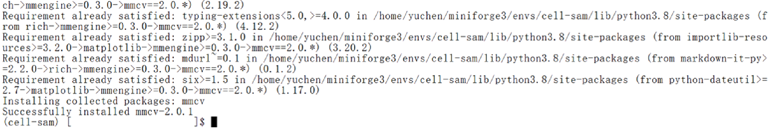
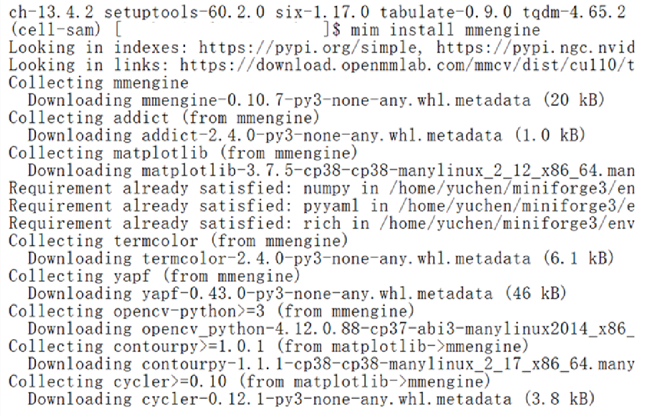
3. Install openmim, it's similar to pip:
5. Install CUDAToolkit by hand , if needed (If it is uncertain whether the server has pre configured CUDA, proceed with this step):
6. The most important step: configure MMCV:
Wait for a few minutes. If there are no errors, the installation could be successful
4. Install mmengine , using mim:
If there is an error, please check the above steps, such as whether the CUDAToolkit is installed correctly, and try different versions of PyTorch (GPU version as a prerequisite), which can be fixed after a simple one or two version changes. Or find more solutions from Issues · open-mmlab/mmdetection (We haven't encountered any more errors, and it has been deployed on over 6 servers, including different CPU and graphics card (1080Ti, 3060, V100, 3080, 3090Ti, 4090), as well as different systems (Windows, Ubuntu, Arch Linux)).

Slide 3
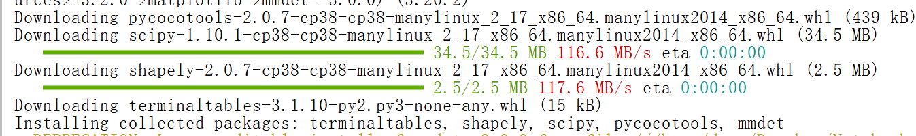
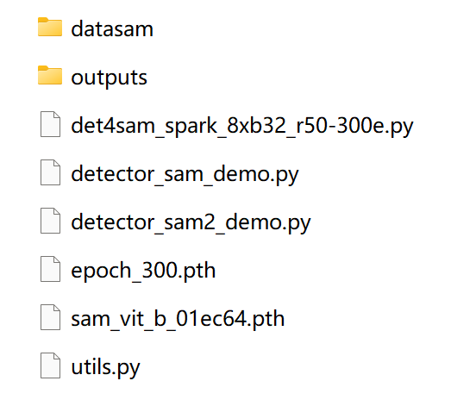
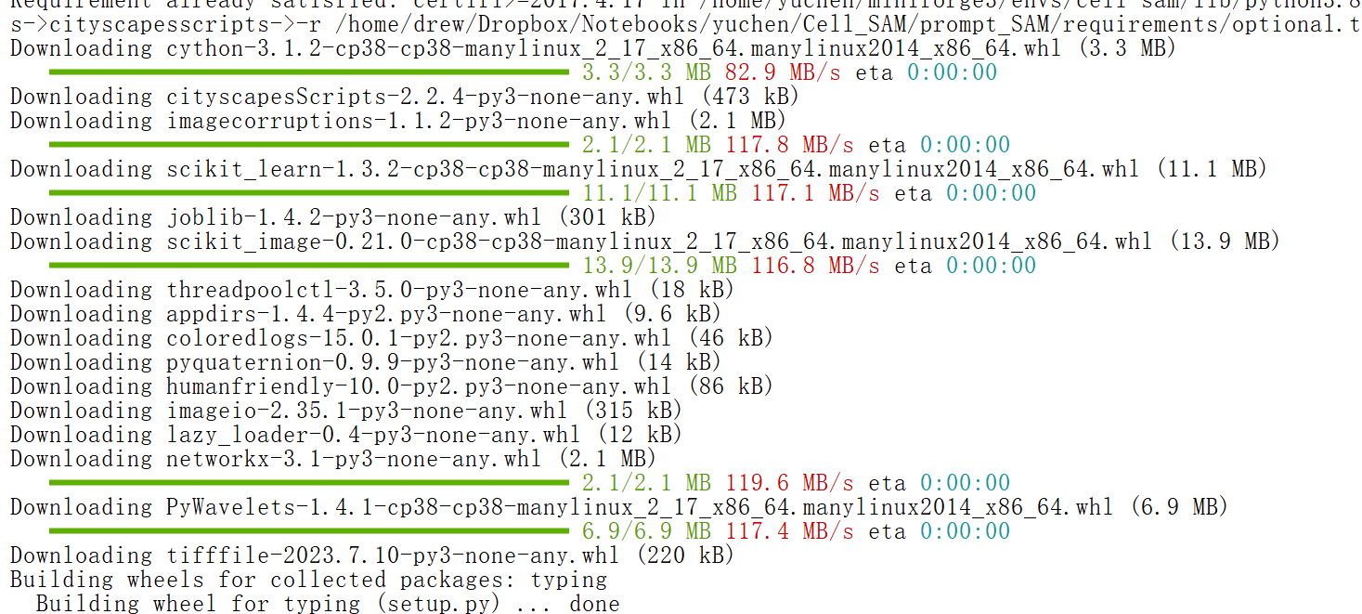
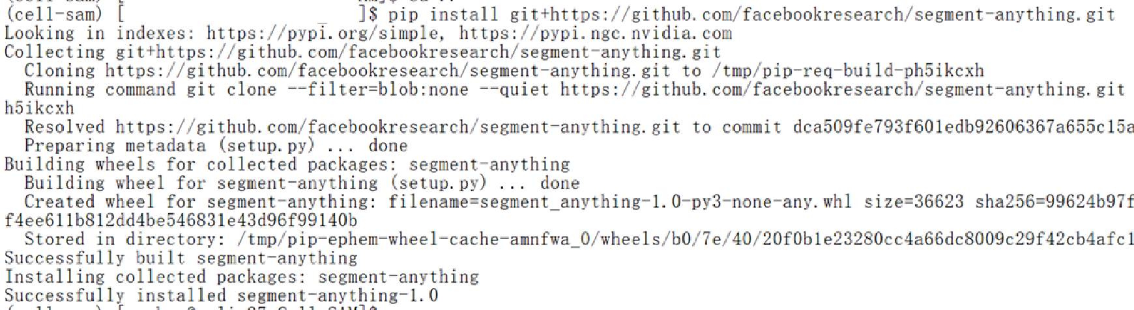
6. Install other used packages and SAM :
7. Test demo:
cd prompt_SAM; pip install -v -e .; pip install -r requirements.txt
Download the dataset and weight files as instructed by GitHub, and place them in the required location. (prompt SAM)
Put the data here
Wait for the results here
Config file of the detection model
Python files combining SAM/SAM2 and detection model
Weight of the detection model
Weight of SAM
Normally, SAM will automatically download the weight file called, but you can also manually download it, if SAM cannot access its website. We use ‘sam_vit_b_01ec64.pth’

Slide 4
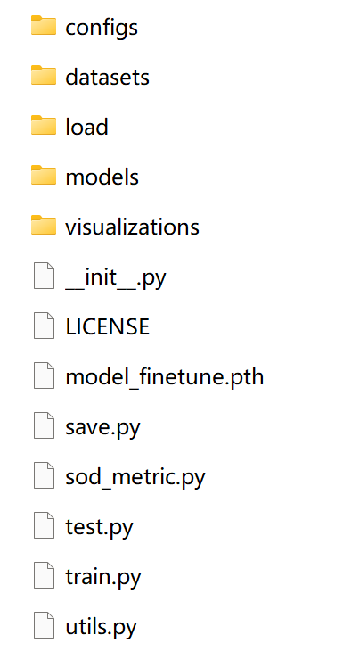
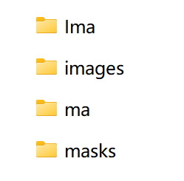
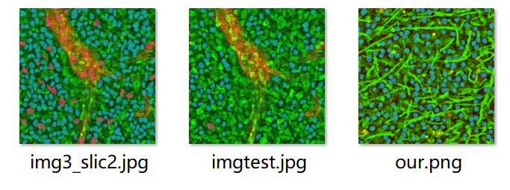
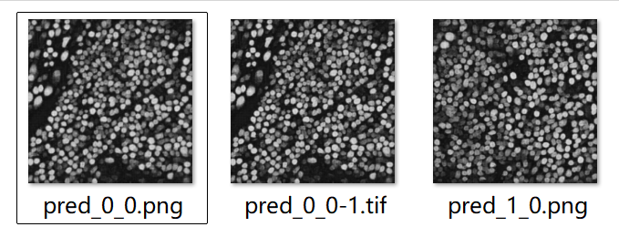
7. Test demo:
8. Get results:
Download the dataset and weight files as instructed by GitHub, and place them in the required location. (finetune SAM)
Enter instructions, wait for the program to run, and obtain visible results.
Config file of the model
Test data path
Prompt-SAM like these, in outputs
Put the data here
Train data path
Test mask path
SAM/SAM2 models
Train mask path
Wait for the results here
Finetined-SAM like these , in visualizations
Weight of the trained model

